Slide 1
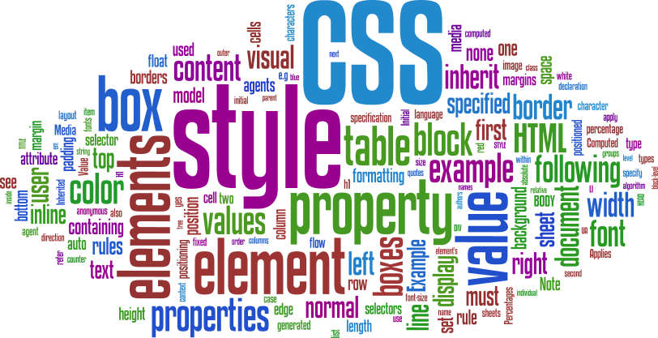

Slide 2
CSS
INTRO
Cascading Style Sheets (CSS) is a simple mechanism for adding style (e.g., fonts, colors, spacing) to Web documents.
index.html
CSS File
about.html
contact.html
A single Cascading Style Sheet file can control the color typography and layout of multiple web pages

Slide 3
CSS
HISTORY
First proposed by Håkon Wium Lie on October 10, 1994
CSS1 released in Dec 1996 – along with Bert Bos
CSS2 released on May 12, 1998 – by the CSS Working Group
CSS3 still under development

Slide 4
CSS
“CASCADING”
Browser Defaults
Embedded Styles
Inline Styles
External (Imported) Styles
Contained in the body of HTML page
Contained in the <head> section of the HTML page
“style” attribute
Separate text file with .css extension
<style> element
Applies only to the specific element
<link> element in the head section provides the URI to the .css file.
Applied to the entire web page

Slide 5

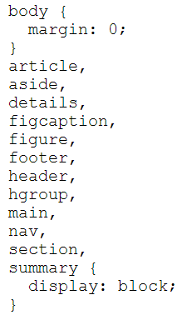
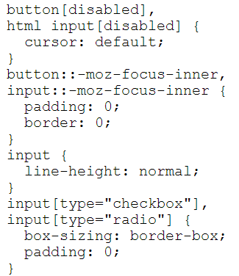
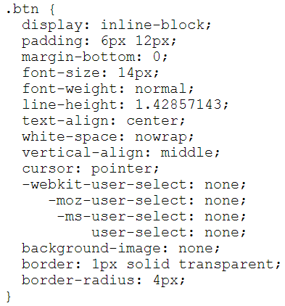
CSS
SYNTAX
SELECTOR
HTML Element Name (just name)
Class Name (“.” + name)
Id Name (“#” + name)

Slide 6
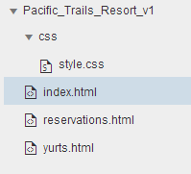
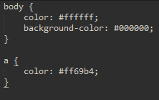
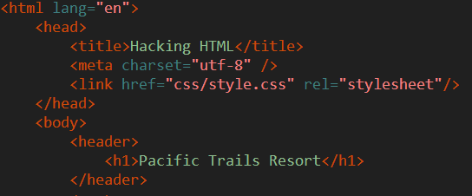
CSS
CSS COLOR
<link href="css/style.css" rel="stylesheet"/>
Change text color to White (#ffffff)
Change Background color to Black (#000000)
Change hyperlink color to Pink(#ff69b4)
Always placed in the header section
TEST
Try using inline/embedded CSS style attribute for the elements!

Slide 7
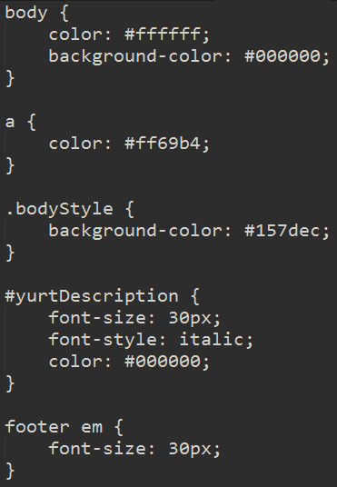
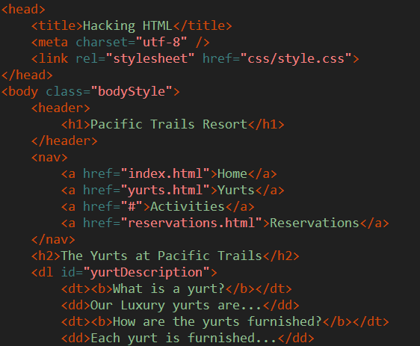
CSS
CLASS / ID SELECTORS
Add Id/Class attributes to elements within yurts.html
“Cascading” witnesses by overriding styles within a css document
Id user more for JS, Class used more for CSS
New font styles introduced
Descendant Selectors – footer > em

Slide 8
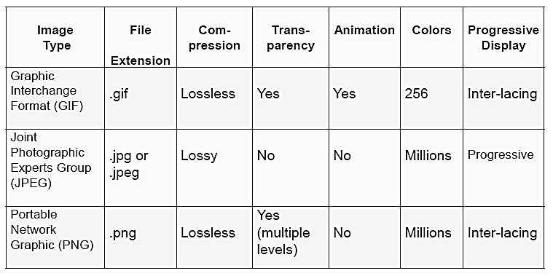
CSS
WEB GRAPHICS

Slide 9
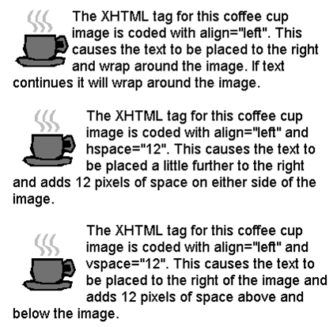
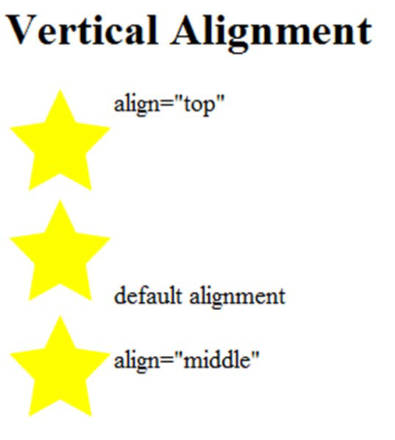
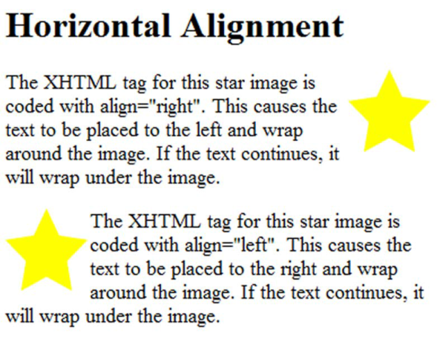
CSS
WEB GRAPHICS
File URI
Height of graphic in pixels
<img src=“cake.png” alt=“birthday cake” height=“100” width=“100”>
Alternate text description (e.g. for disabled people)
Width of graphic in pixels
Align = ?
<img> align attribute
hspace attribute
vspace
attribute

Slide 10
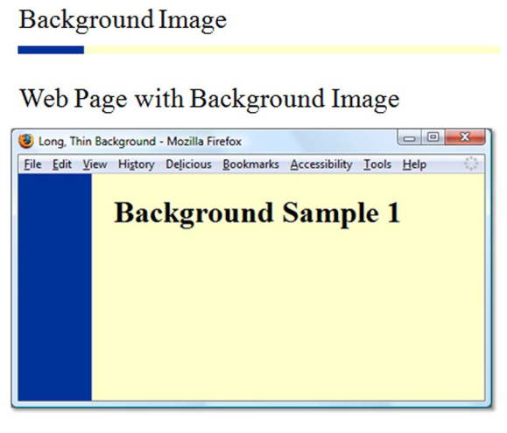
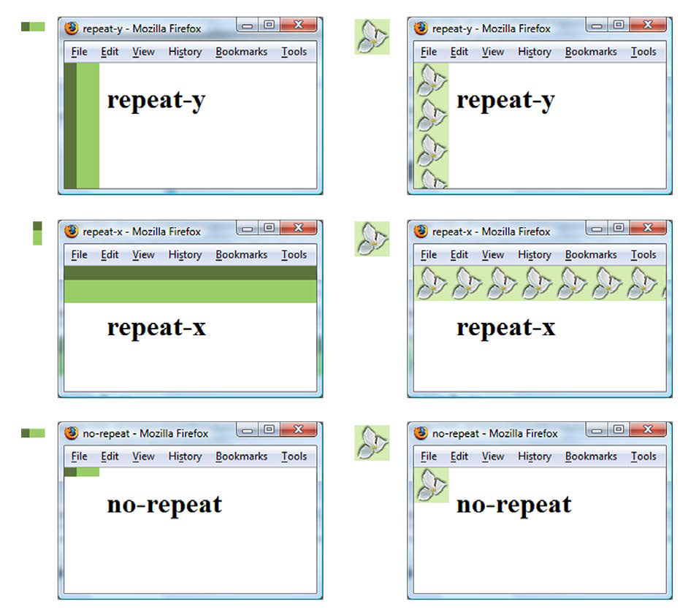
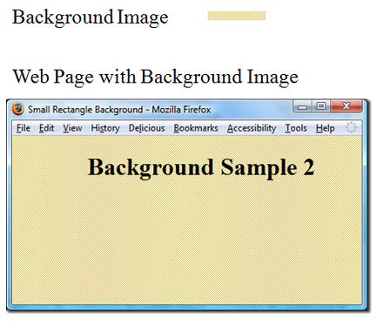
CSS
CSS PROPERTIES - BACKGROUND
body {
background-image: url(background.png);
background-repeat: no-repeat;
}
* By default images tile (repeat)

Slide 11
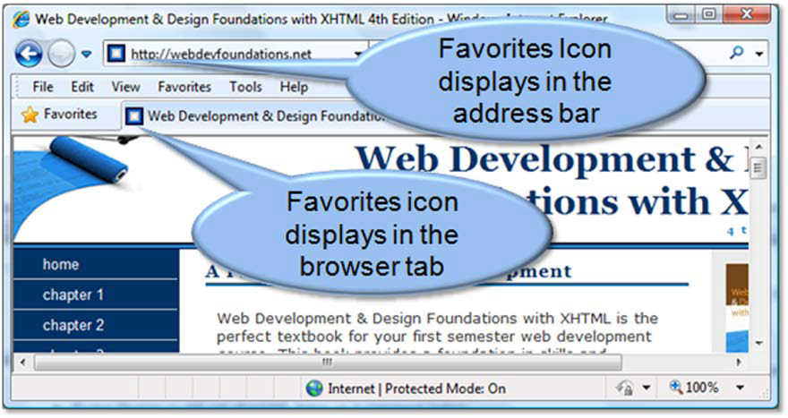
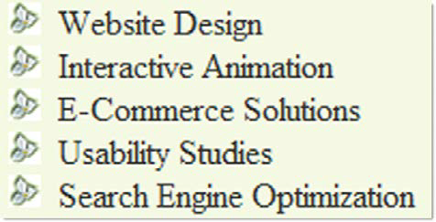
CSS
CSS PROPERTIES -
FAVORITES ICON / LIST MARKERS
ul {
list-style-image: url(flower.png);
}
<link rel="icon" href="favicon.ico" type="image/x-icon" />
* Generally of size 16px x 16px

Slide 12
CSS
CSS FONT PROPERTIES
font-family | Arial | Helvetica | sans-serif (can be other font families. last is the fallback)
font –size | 90% OR 35px (can be given as % or pixels)
font-weight | bold | bolder | light | lighter | normal | inherit | 100-900 (in increments of 100)
font-style | normal | italic | oblique
@font-face | font-family | src (e.g. something like url(webfont.woff))
line-height | normal | 3.5 (relative to element’s font size) | 3em | 34% (relative to element’s font size)
text-align | start | end | left | right | center | justify | match-parent | start end
text-indent | 3mm | 30px | 15% (relative to element’s font size) | each-line | hanging
letter-spacing | normal | initial | inherit | 3mm | 3px
width | auto | inherit | 100% | 200px | 30em
height | auto | inherit | 100% | 200px | 30em
Notes:
@font-face allows you to load web fonts instead of just relying on the system fonts installed on a machine.

Slide 13
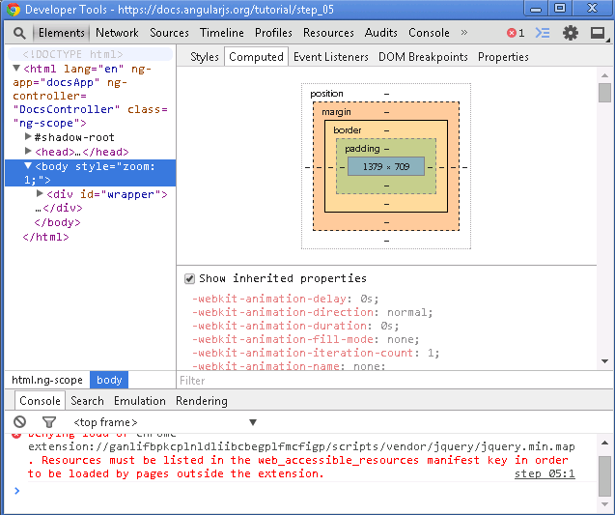
CSS
BOX MODEL
Content
Padding
Border
Margin
Top/Bottom/Left/Right

Slide 14
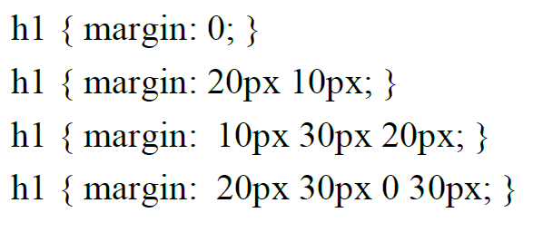
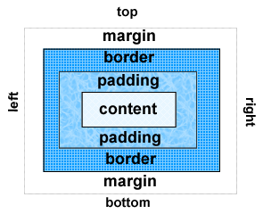
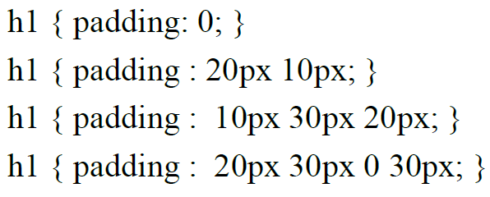
CSS
MARGIN / PADDING
Clockwise property: top right bottom left
Notes:
=

Slide 15
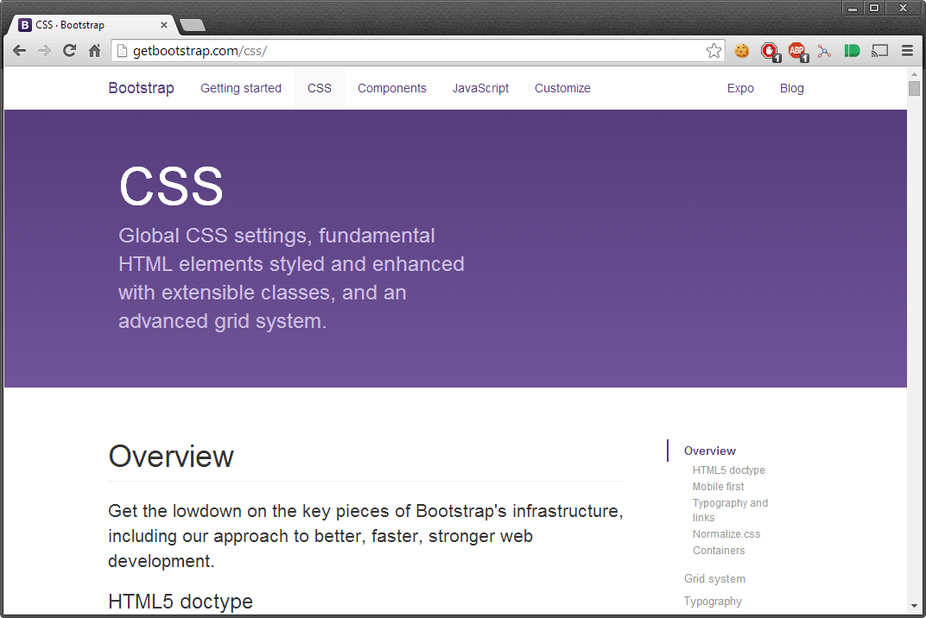
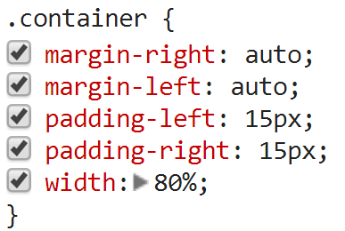
CSS
PAGE CENTERING
Demo for Pacific Trails Resort

Slide 16
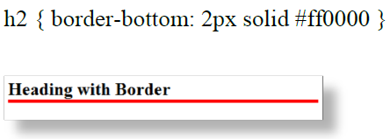
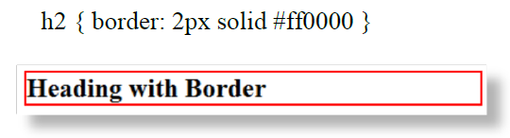

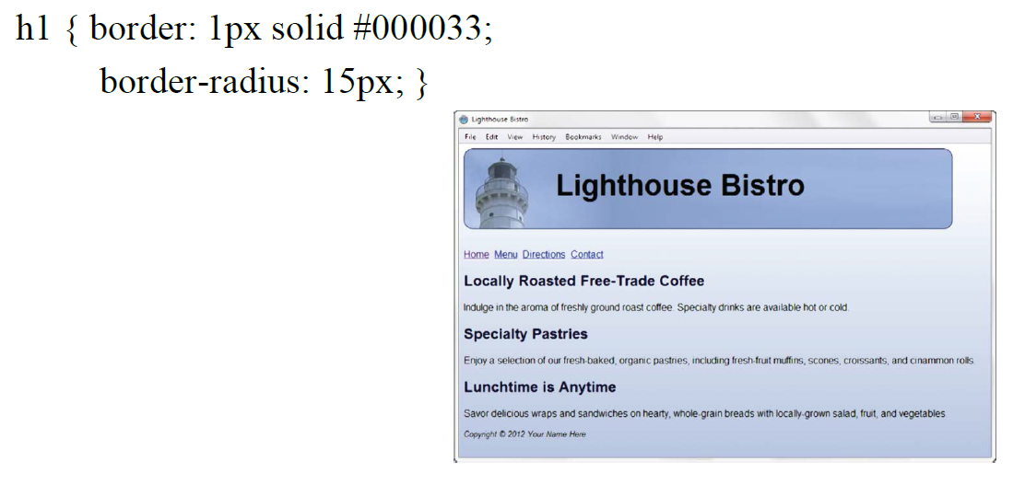
CSS
BORDER

Slide 17
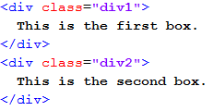
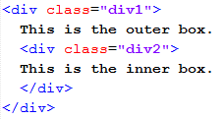
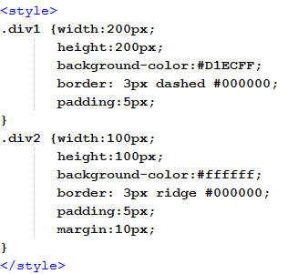
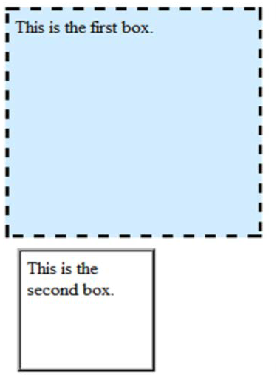
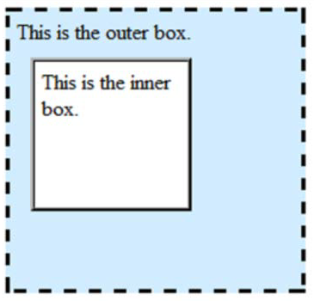
CSS
PAGE LAYOUT (BASIC)

Slide 18
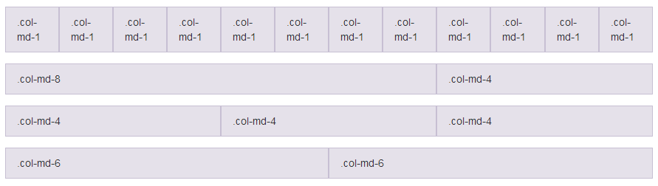

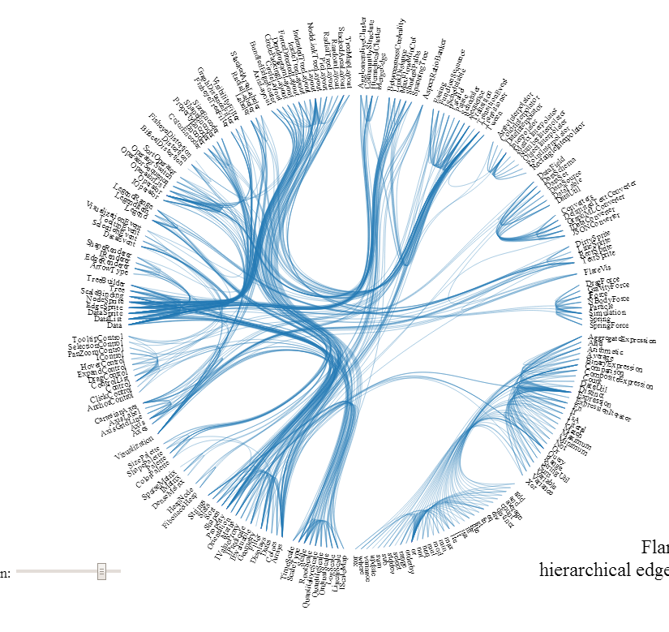
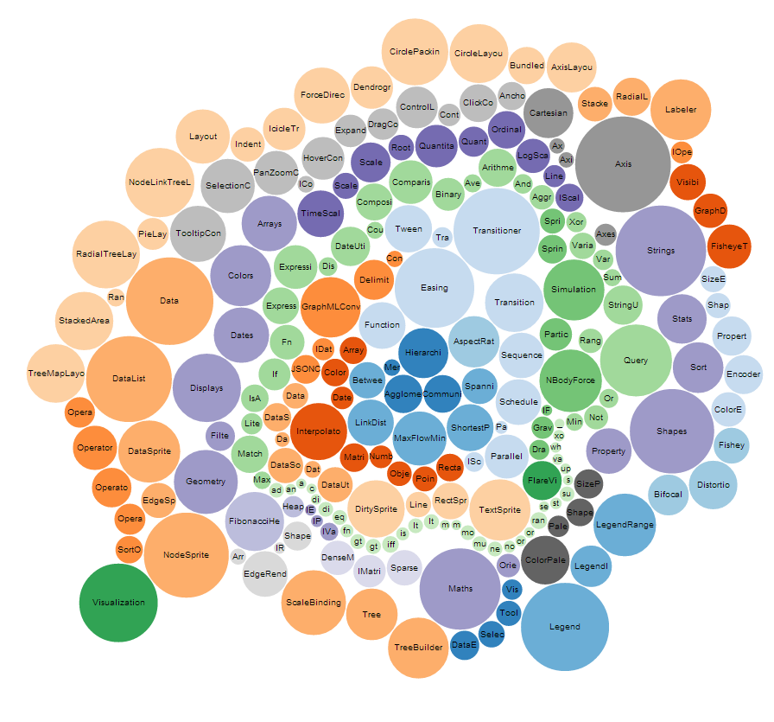
CSS
PAGE LAYOUT (ADVANCED)
GRID LAYOUTS
Bootstrap
Foundation
NON-GRID LAYOUTS
D3.js

Slide 19
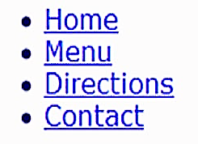

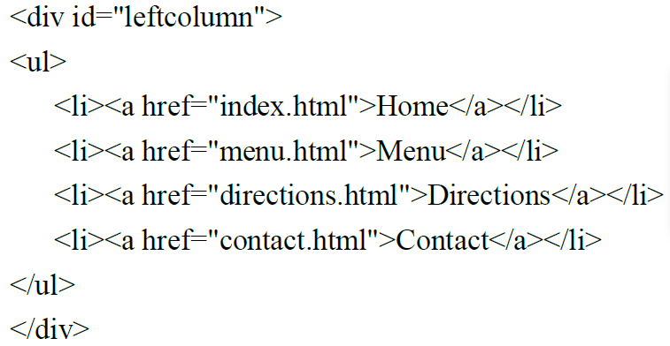
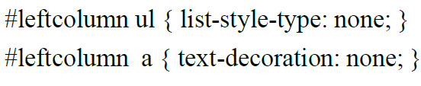


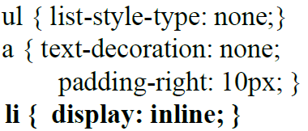
CSS
NAVIGATION
Remove list dots and text underline

Slide 20
CSS
PSEUDO CLASSES
selector:pseudo-class { property:value; }
Defines a special state of an element
:active
:focus
:hover
:first-child
:last-child
:nth-child(n)
:visited
http://www.w3schools.com/css/tryit.asp?filename=trycss_link

Slide 21
CSS3

Slide 22
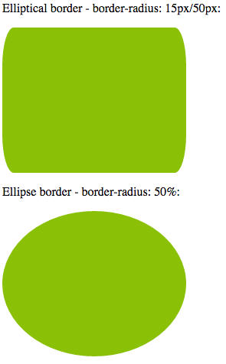
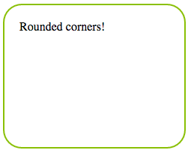
CSS3
ROUNDED BORDERS
#corners {
border-radius: 25px;
}
Applied in the order: top-left , top-right, bottom-right, bottom-left

Slide 23
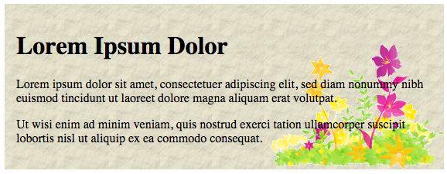
CSS3
EXTRA BACKGROUND
Multiple background images
Background sizes (Height-Weight, cover, contain)
Background origin
Background clip
#example1 {
background: url(img_flwr.gif) right bottom no-repeat, url(paper.gif) left top repeat;
}
http://www.w3schools.com/css/tryit.asp?filename=trycss3_background-clip

Slide 24
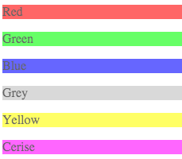
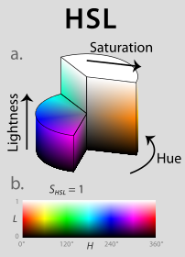
CSS3
EXTRA BACKGROUND
HSL/HSLA colors – hue, saturation, lightness, alpha – cylindrical color system
RGBA colors – red, green, blue, alpha
opacity
#p1 {background-color:rgb(255,0,0);opacity:0.6;}
#p2 {background-color:rgb(0,255,0);opacity:0.6;}
#p3 {background-color:rgb(0,0,255);opacity:0.6;}
#p4 {background-color:rgb(192,192,192);opacity:0.6;}
#p5 {background-color:rgb(255,255,0);opacity:0.6;}
#p6 {background-color:rgb(255,0,255);opacity:0.6;}

Slide 25





CSS3
GRADIENTS
Linear
Radial
background: linear-gradient(direction, color-stop1, color-stop2, ...);
background: radial-gradient(shape size at position, start-color, ..., last-color);
default direction is “top to bottom”
default, shape is ellipse, size is farthest-corner, and position is center
background: linear-gradient(to bottom right, red , blue);
background: radial-gradient(red, yellow, green);

Slide 26

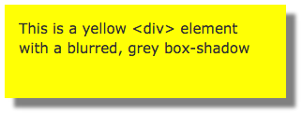
CSS3
SHADOW EFFECTS
text-shadow
box-shadow
Order of definition: horizontal-shadow, vertical-shadow, blur-size, shadow-color
h1 {
text-shadow: 2px 2px 5px red;
}
h1 {
box-shadow: 10px 10px 5px grey;
}

Slide 27
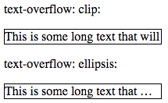
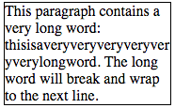
CSS3
TEXT
div.test {
text-overflow: clip;
overflow: hidden;
white-space: nowrap;
}
text-overflow
div.test:hover {
text-overflow: inherit;
overflow: visible;
}
p.test {
width: 11em;
border: 1px solid #000000;
word-wrap: break-word;
}
word-wrap

Slide 28
CSS3
FONTS
@font-face {
font-family: myFirstFont;
src: url(sansation_light.woff);
}
div {
font-family: myFirstFont;
}

Slide 29
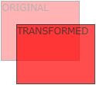


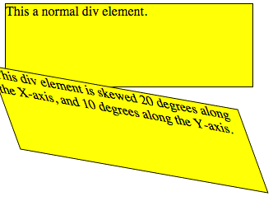
CSS3
2D TRANSFORMS
translate()
rotate()
scale()
skewX()
skewY()
matrix()
div#myDiv {
-ms-transform: rotate(20deg); /* IE 9 */
-webkit-transform: rotate(20deg); /* Safari */
transform: rotate(20deg); /* Standard syntax */
}

Slide 30
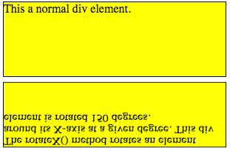


CSS3
3D TRANSFORMS
div {
-webkit-transform: rotateX(150deg); /* Safari */
transform: rotateX(150deg);
}
rotateX()
rotateY()
rotateZ()

Slide 31


CSS3
TRANSITIONS
div {
width: 100px;
height: 100px;
background: red;
-webkit-transition: width 2s; /* Safari */
transition: width 2s;
}
div:hover {
width: 300px;
}
http://www.w3schools.com/css/css3_transitions.asp

Slide 32
CSS3
ANIMATIONS
Hardware Accelerated using the GPU
Changes many CSS properties together at once into another
@keyframes: specifies the animation code
animation-duration: time taken for one animation cycle
animation-name: name of the @keyframes animation
animation-timing-function: speed curve of an animation
h1 {
animation-duration: 3s;
animation-name: slidein;
}
@keyframes slidein {
from {
margin-left: 100%;
width: 300%;
}
to {
margin-left: 0%;
width: 100%;
}
}
http://www.w3schools.com/css/css3_animations.asp

Slide 33


CSS3
The viewport is the user's visible area of a web page
VIEWPORT
<meta name="viewport" content="width=device-width, initial-scale=1.0">

Slide 34

CSS3
GRID VIEW
* {
box-sizing: border-box;
}
[class*="col-"] {
float: left;
padding: 15px;
border: 1px solid red;
}
.col-1 {width: 8.33%;}
.col-2 {width: 16.66%;}
.col-3 {width: 25%;}
.col-4 {width: 33.33%;}
.col-5 {width: 41.66%;}
.col-6 {width: 50%;}
.col-7 {width: 58.33%;}
.col-8 {width: 66.66%;}
.col-9 {width: 75%;}
.col-10 {width: 83.33%;}
.col-11 {width: 91.66%;}
.col-12 {width: 100%;}

Slide 35
CSS3
RESPONSIVE IMAGES
img {
width: 100%;
height: auto;
}
img {
max-width: 100%;
height: auto;
}
If the max-width property is set to 100%, the image will scale down if it has to, but never scale up to be larger than its original size

Slide 36

CSS3
MEDIA QUERIES
@media only screen and (max-width: 500px) {
body {
background-color: lightblue;
}
}
@media only screen and (orientation: landscape) {
body {
background-color: lightblue;
}
}

Slide 37
BOOTSTRAP DEMO
exercises/bootstrap.html
getbootstrap.com

